Slide 1
INDUSTRIAL RESEARCH ASSISTANCE PROGRAM (IRAP)
Helping small and medium-sized businesses grow
July 2019
Notes:
These are some general slides on IRAP, please select most appropriate slides to suit your audience.

Slide 2
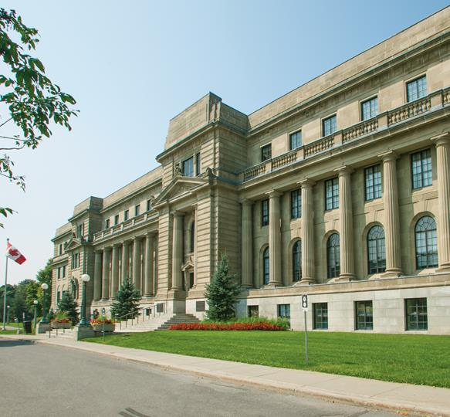

The National Research Council of Canada
MANDATES
  Business innovation
  Policy solutions for government
  Advancing knowledge
RESOURCES
  2,151 scientists, engineers, technicians,
  other specialists
  255 IRAP industrial technology advisors
  179 buildings in 22 locations
NATIONAL RESEARCH COUNCIL CANADA
Notes:
As Canada’s largest federal research and development organization, the NRC is committed to advancing knowledge through science, supporting business innovation, and supporting the Government of Canada’s science agenda, including the Innovation and Skills Plan.
Each year our scientists, engineers and business experts work closely with thousands of Canadian firms, helping them bring new technologies to market.
We have the people, expertise, services, licensing opportunities, national facilities and global networks to support Canadian businesses.
We are well positioned, both in Canada and abroad, to create and maintain valuable linkages and networks to help transfer science and technology information to firms, universities and public sector partners, and to generate new business opportunities for Canadian small and medium enterprises (SMEs).
We partner with Canadian industry to take research impacts from the lab to the marketplace, where people can experience the benefits. This market-driven focus delivers innovation faster, enhances people's lives and addresses some of the world's most pressing problems.

Slide 3

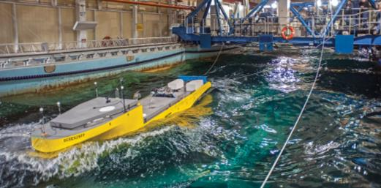


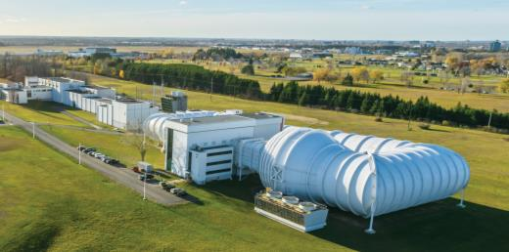
Support for research
OVER 100 YEARS OF RESEARCH EXCELLENCE
MULTI-DISCIPLINARY RESEARCH FACILITIES AND STAFF
NATIONAL RESEARCH COUNCIL CANADA
Notes:
The NRC has existed as part of Canada’s research and development landscape since 1916, and has produced breakthroughs and solutions that have impacted and improved the lives of Canadians.
We are building on this legacy of discovery, and pushing the boundaries of science and research to develop the next-generation of solution and innovation.

Slide 4
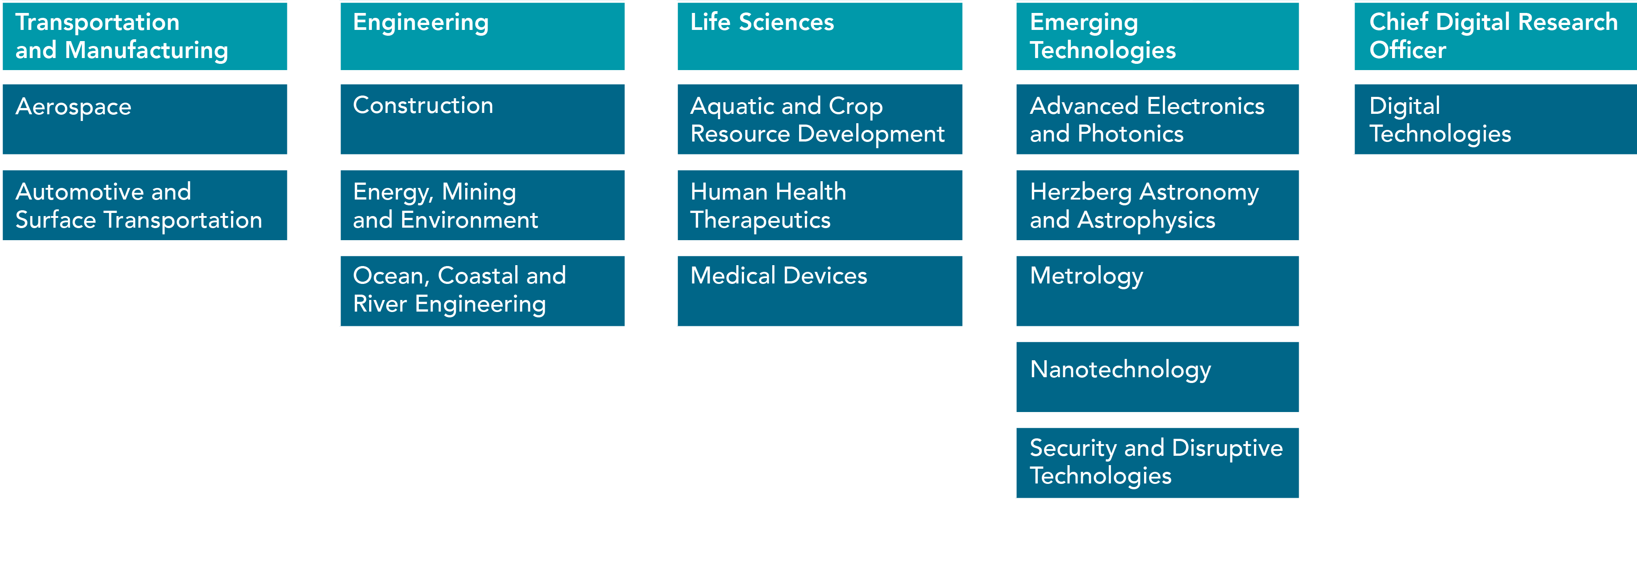
The NRC research centres
NATIONAL RESEARCH COUNCIL CANADA
Notes:
The NRC comprises five integrated R&D divisions, each guided by advisory bodies composed of industry leaders.
Under these five R&D divisions, there are 14 integrated and consolidated Research Centres focused on key industry sectors, our areas of R&D.
These Research Centres represent areas of strategic importance and economic value for Canada.
Each Research Centre hosts a variety of research programs which draw expertise from across the NRC and outside the NRC (industry, government, academia)

Slide 5

Notes:
NRC IRAP is a key component of the NRC and is one of the Government of Canada’s primary mechanisms for providing innovation support to Canadian (SMEs).
NRC IRAP is designed to stimulate innovation in Canadian SMEs by helping them access, develop, exploit, and apply technologies to create new products, services and industrial processes.

Slide 6
Industrial Research Assistance Program
Mandate
STIMULATE WEALTH CREATION for Canada through innovation
ACCELERATE THE GROWTH of small and medium-sized businesses by providing them with a comprehensive suite of innovation services and funding
BE THE MOST IMPACTFUL PROGRAM of its kind in the world, where Canadian firms go first to transform their ideas into commercial success
Mission
Vision
NATIONAL RESEARCH COUNCIL CANADA

Slide 7
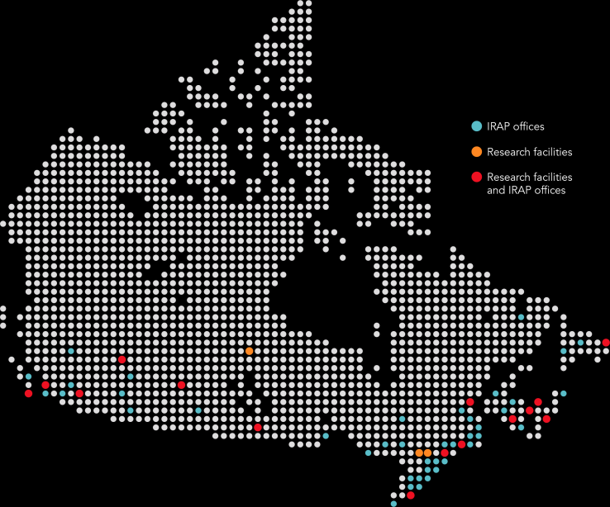
IRAP at a glance
2018-19 Overview
Total invested in SMEs: $293.4 million
Total IRAP reach (funding and advice): 8,159
Number of firms funded: 3,541
Jobs supported: 15,662
Assessments completed for OGDs: 1,350
255 Industrial Technology Advisors
Services
Technical and business advisory services
Financial assistance
Linking SMEs with local and international opportunities
LOCATED ACROSS
CANADA IN 120 COMMUNITIES
Impact on clients
27% increase in revenues
18% increase in employees
NATIONAL RESEARCH COUNCIL CANADA
Notes:
Re: stats:
Number of firms funded: 3,255 (firms that received project funding in FY 2017/2018, including continuing projects from previous fiscal year(s)

Slide 8








IRAP organizational chart
DAVID LISK
Vice President, IRAP
EXECUTIVE DIRECTORS
CHRIS RYAN
IRAP Pacific
& Yukon
LAURAL
PORTH-JONES
(Acting)
IRAP Prairies
& Northwest Territories
MIKE CURRY
IRAP Ontario
LLYNNE PLANTE
IRAP Quebec
ROBERT FAULDER (Acting)
IRAP Atlantic
& Nunavut
BRAD GOODYEAR
IRAP Division Services
MELANIE CULLINS
International
NATIONAL RESEARCH COUNCIL CANADA

Slide 9
Helping businesses prosper
WE HELP REMOVE PAIN POINTS FOR BUSINESSES INCLUDING:
    Capital and financing
    Human resource talent
    Export market access and knowledge
    Technology (adaptation and insight)
Market knowledge/intelligence
CxO talent
Productivity enhancement
Strategy development
NATIONAL RESEARCH COUNCIL CANADA

Slide 10
IRAP advantage
ITA
LOCAL PRESENCE
NETWORK
SMART MONEY
RELATIONSHIPS
NATIONAL RESEARCH COUNCIL CANADA
Notes:
Smart Money = providing the right amount of funding at the right time.

Slide 11

Industrial technology advisors
  Private sector experience
  Later in career cycle (typically 20+ years experience)
  Senior managers and entrepreneurs
  Most have an engineering or science background
NATIONAL RESEARCH COUNCIL CANADA
Notes:
Industrial Technology Advisors (ITAs) are at the core of IRAP’s delivery. There are some 255 ITAs located in communities across Canada. ITAS serve as trusted advisors, they assist clients through every aspect of the innovation process, providing the unique blend of expertise, information and resources to help meet client needs and help them succeed.

Slide 12
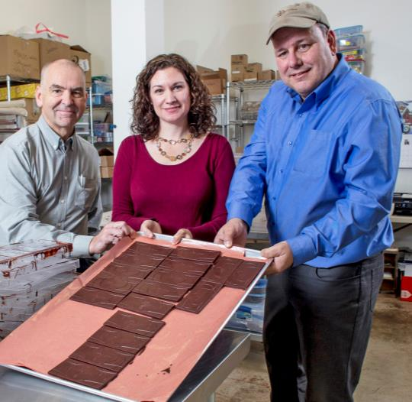
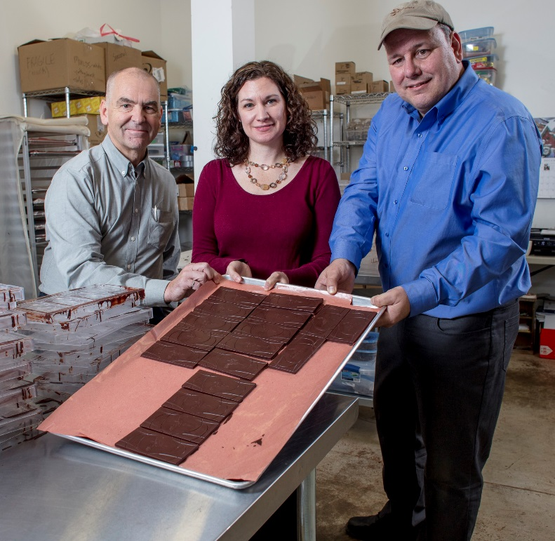
Advisory services
OUR ITAs WORK WITH CLIENTS THROUGH EVERY ASPECT OF THE INNOVATION PROCESS, PROVIDING
    technical and business advice;
    referrals to other programs and services;
    linkages and networking with appropriate
    resources/ expertise searches;
    strategic intelligence
NATIONAL RESEARCH COUNCIL CANADA

Slide 13

IRAP engagement model
Business advice
Linkages
Strategic intelligence
Technical expertise
ADVISORY SERVICES
$
IRAP R&D projects
Youth employment
International
ADVISORY
SERVICES
Strategic Intelligence
Technical Expertise
NATIONAL RESEARCH COUNCIL CANADA
Notes:
IRAP
Assists Canadian SMEs with their R&D projects, and provides funding to a small # of organizations that provide direct services to innovative SMEs.
Youth
Helps SMEs hire highly-skilled post-secondary graduates
International:
Canadian International Innovation Program (CIIP):
Supports SMEs’ R&D collaboration with international partners in Brazil, China, India, Israel and South Korea.
EUREKA, Eurostars:
Supports SMEs’ R&D collaboration with partners in over 40 economies from the EU, Europe, Israel, South Korea.

Slide 14
IRAP clients by industry sector
Source: FY 2018-2019
NATIONAL RESEARCH COUNCIL CANADA
Notes:
IRAP services clients across ALL industry sectors
Firms funded in FY 2018-2019
IRAP Classification # of Firms Percentage:
Aerospace 26 0.73%
Agriculture & Food 290 8.19%
Construction & Related Products - Services 308 8.70%
Energy & Resources 322 9.09%
Health & Life Sciences 320 9.04%
ICT (Digital Economy) 1471 41.54%
Manufacturing & Materials 458 12.93%
Others 346 9.77%
Total 3541 100.00%

Slide 15
IRAP clients by company size
Source: FY 2018-2019
# OF FIRMS
# OF EMPLOYEES
NATIONAL RESEARCH COUNCIL CANADA
Notes:
Firms funded in FY 2018-2019
Employees Profile # of Firms Percentage:
1 to 10 1904 53%
11 to 20 609 18%
21 to 50 530 15%
51 to 100 251 7%
101 to 300 211 6%
301+ 36 1%
Total 3541 100.00%
*91 firms entered as 0 employees (these have been included in the 1 to 10 employee range)

Slide 16
IRAP sector teams
  Link innovative Canadian SMEs to global value chains
  Support SME growth by providing access to current technology and business market intelligence on priority industry sectors
  Increase the positive impact of NRC
  on innovative SMEs.
  Contribute to the competitiveness
  of Canadian industry.
  Strengthen Canada’s innovation system.
Advanced Manufacturing
Aerospace • AgriFood BioMedical • BioProducts CleanTech • Construction
ICT • Mining
NATIONAL RESEARCH COUNCIL CANADA
Notes:
IRAP sector teams represent key industry groupings . Their role is to be the “go-to experts” on their particular sector for IRAP, NRC and other government departments, by keeping up-to-date on the latest trends, innovations and advancements in their area of focus for the benefit of SMEs.
Each sector team has a lead and an IRAP ITA representative from geographical areas in which there is Canadian SME capacity in the technology sector. Each team also has a resource from NRC Knowledge Management. The teams coordinate and collaborate through regular meetings, with the team leader in an overall coordinating role.
Client inclusiveness
In March 2019, IRAP created a new sector team to ensure that the Program in engaging with clients in a an inclusive manner, representative of the rich and diverse makeup of our country. This includes improving engagement with: businesses owned/led by women, visible minorities, indigenous peoples, and people with disabilities.

Slide 17

IRAP offers funding
to Canadian SMEs that have the potential and willingness to grow through innovation
Notes:
IRAP offers several different funding programs that compliment its advisory services.
Our formula - providing the right money at the right time to the right client.
We work with firms to de-risk their innovation costs and co-invest in heir growth and development.
Meeting the basic eligibility criteria does not necessarily guarantee funding.
Before entering into a financial commitment with a client, both the firm and the project are evaluated on an individual basis during a consultation with one of IRAP Industrial Technology Advisors (ITAs).

Slide 18
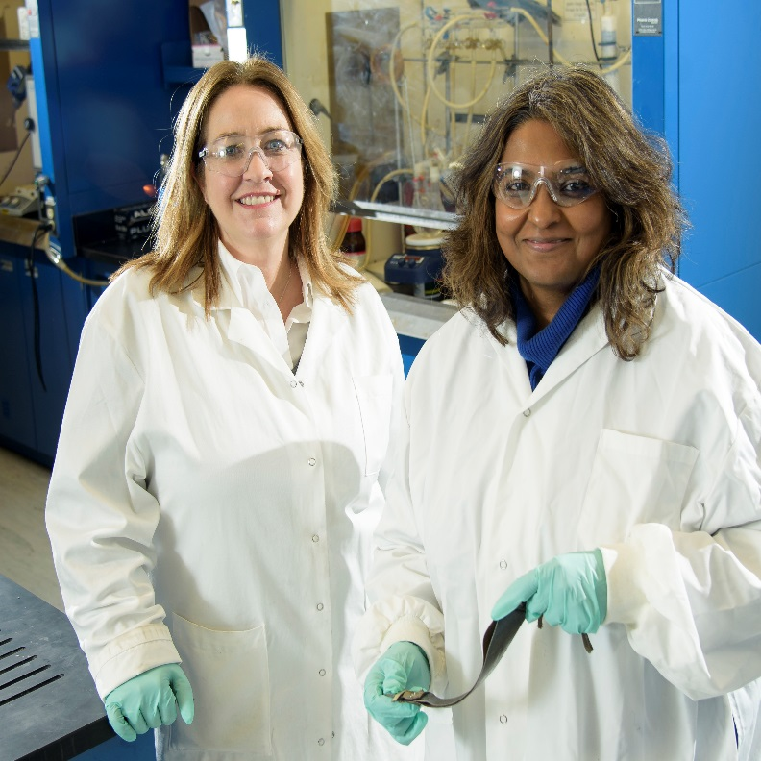

Who can we select?
BASIC ELIGIBILITY
Incorporated SME operating in Canada
500 or fewer employees
Objective to grow through innovation
ASSESSMENT OF THE BUSINESS
    Business opportunity
    Management & financial capabilities
    Potential to achieve expected outcomes
    Plan to commercialize results
NATIONAL RESEARCH COUNCIL CANADA

Slide 19
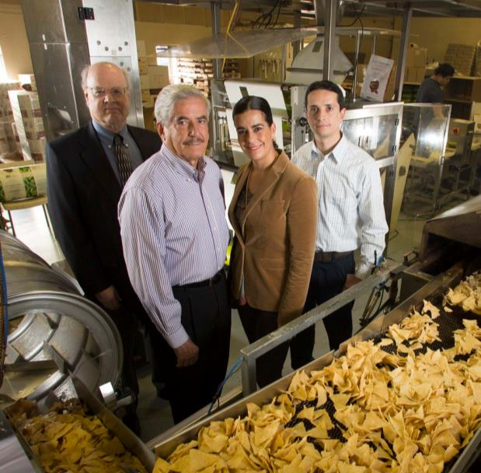
Who can we select?
ASSESSMENT OF THE PROJECT
    Project plan and challenges
    R&D team’s capacity to achieve success
    Potential impact on the firm and Canada
NATIONAL RESEARCH COUNCIL CANADA

Slide 20

GROW GLOBAL
International co-innovation opportunities for Canadian SMEs
Connect to programs and expertise
Improve competitiveness
Tap into emerging markets and
innovative developed markets
NATIONAL RESEARCH COUNCIL CANADA
Notes:
IRAP’s International Networks Team (INT) are expert advisors in identifying best fit international programs for Canadian SMEs.
IRAP invests in building international relationships to connect our clients to global value chains
Through these relationships, we help our clients identify R&D and commercialization opportunities with world-class organizations across the globe.
The reach of the IRAP network includes many regional, national and international organizations, all of which play a role in strengthening the innovation support system in a way that benefits SMEs in Canada.
IRAP’s international initiatives are focused on providing support in a number of key areas, including direct support to SMEs with international interests, technology partnering and joint R&D projects.
We consider our mission accomplished when they become self-sustained, globally competitive businesses.

Slide 21




Helping SMEs succeed globally
IRAP CONNECTS CLIENTS TO
THE GLOBAL VALUE CHAIN
    SUPPORTED PROGRAMS:
EUREKA
Eurostars™
Canadian International Innovation Program (CIIP)
CanExport
Large enterprise initiative
Sector teams
Tools to support international growth
NATIONAL RESEARCH COUNCIL CANADA

Slide 22
Working with stakeholders
IRAP offers program delivery expertise and advisory services to other federal and provincial organizations including:
    Program design
    Proposal assessments
    Program management
    Full program delivery
1,350
technical and business assessments for OGDs
NATIONAL RESEARCH COUNCIL CANADA
Notes:
IRAP offers its program delivery expertise and services to OGDs to help them delivery complimentary innovations assistance programs for SMEs. IRAP offers full program delivery on behalf of OGDs or select services (i.e. technical and business assessments, etc.)
Examples of partnerships (2018/2019) – to name a few
Build in Canada Innovation Program (BCIP) with Public Services and Procurement Canada
Innovative Solutions Canada (ISC) with Innovation, Science & Economic Development Canada
Low Carbon Economy Challenge (LCEC) with Environment & Climate Change Canada
Innovation for Defence Excellence and Security (IDEaS) with Defence Research and Development Canada (DRDC)
Atlantic Innovation Fund (AIF) with Atlantic Canada Opportunities Agency
RDC Commercial Programs with the Research and Development Corporation Newfoundland and Labrador
BC Ignite with BC Innovation Council (changed to Innovate BC)
Sask Technology Startup Incentive (STSI) with the Government of Saskatchewan Ministry of Economy

Slide 23

SUCCESS STORIES
Notes:
Please pick and choose success stories as necessary
Other examples available at www.nrc-cnrc.gc.ca

Slide 24
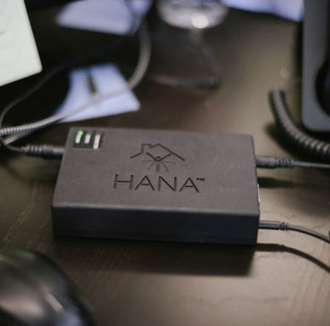
International collaboration opens doors to Canadian smart health innovators
"This is the way of the future – to tackle big challenging problems through innovative R&D collaboration with many different players around the world. Our ITAs have worked hard to really know us, and identified where we might have difficulties in such a complex venture. They have a great sense of what is likely to work."
David Kuik
CEO, Norima Consulting
NATIONAL RESEARCH COUNCIL CANADA
Notes:
https://www.nrc-cnrc.gc.ca/eng/irap/success/2018/norima_consulting.html
Norima Consulting is a key player in EUREKA’s ITEA 3 program and a participant in Medolution - an international R&D project consortium aimed at developing smart health solutions for populations with chronic and complex health conditions.
Led by Philips Healthcare, a Dutch health solutions multinational corporation, Medolution brings together 19 participants from 5 different countries, through the ITEA 3 cluster process, where large enterprises, small and medium-sized enterprises (SMEs), universities, and other players collaborate on industry-driven, pre-competitive R&D in software innovation.
Norima is leading the development of three major innovations as part of its contribution to the consortium:
HanaTM – cloud based environmental control and accessibility platform that empowers individuals who have severe mobility challenges to control their personal environment and provides remote monitoring capabilities for caregivers and care providers.
SmartSpeedTM - enables multidisciplinary healthcare teams to conduct video consultations and coordinated post-assessment work at a distance.
Norima’s state-of-the-art data anonymization software – allows health care administrators and researchers to study aggregate sets of health data while ensuring individual privacy.

Slide 25

High tech real estate enterprise thrives on time-tested mentorship
“The support from NRC IRAP allowed us to stretch and hire long before we could have.”
Lauren Haw
CEO, Zoocasa
NATIONAL RESEARCH COUNCIL CANADA
Notes:
https://www.nrc-cnrc.gc.ca/eng/irap/success/2017/zoocasa.html
Zoocasa
Developed a disruptive strategy to make the purchasing experience in the real estate sector smoother and more seamless for everyone involved
NRC-IRAP’s advisory services assisted Lauren Haw, CEO Zoocasa, to win a competitive bid in 2015. With continued support from ITA John Shannon the firm redesigned operating structures early on, setting it apart from competitors.
Growth: 5 team members in 2015 to 50 in 2017
Operations currently concentrated on the GTA, and looking to replicate in other major markets across Canada

Slide 26

Overcoming growth hurdles
“In my 30-year career, I’ve never seen a program that responds so well to the needs of investors and innovative SMEs, and creates value for both those groups.”
Claude Martel
CEO, Inno-centre
NATIONAL RESEARCH COUNCIL CANADA
Notes:
Inno-centre
Inno-centre provides technology entrepreneurs and venture capital (VC) investors with individualized, in-depth coaching to prepare them for growth. Added value resides in the quality of Inno-centre's sectoral expertise and its business intelligence for client success. CAIP funding, through IRAP, has allowed Inno-centre to
Extend services to investors and SME executives at different business phases
Expand the incubator’s in-house professionals by partnering with additional couches rom respected companies to directly support SMEs
Develop a suite of unparalleled services
Inno-centre’s model works with 77 completed projects with companies that collectively obtained nearly $200M in investments between 2014 to the close of 2016.
One example – AddÉnergie - Inno-centre’s client that earned $13M in capital and formed and executed a business plan to win investors and North American clients with support from CAIP. AddÉnergie shifted from the manufacturing and sales of commodities – battery chargers for electric vehicles – to becoming an infrastructure supplier and service provider for "smart" electric-charging stations.

Slide 27

Breakthrough in custom metal fabrication supports advanced research
“The R&D we need to grow and succeed is risky and unusual. NRC IRAP has really helped us leap into the future of advanced manufacturing."
Doug Milburn,
Co-founder and Director of Sales & Marketing, Protocase Inc.,Sydney, Nova Scotia
NATIONAL RESEARCH COUNCIL CANADA
Notes:
https://www.nrc-cnrc.gc.ca/eng/irap/success/2018/protocase.html
Protocase uses ultra-lean manufacturing techniques to produce customized electronic enclosures for prototypes at unparalleled speed for leading-edge research in the aerospace, information technology and defence industries.
Thanks to support from IRAP, the company is revolutionizing the steel fabrication and machining business.
takes a product from design to completion in two to three days using ultra-lean manufacturing techniques (unparalleled speed for specialized one-off work)
delivers customized metal enclosures at consistently high levels of quality and with competitive pricing
serves more than 12,000 engineers, scientists, and design professionals working at the outer limits of technology in industries as diverse as aerospace, information technology, driverless transportation, renewable energy and defence.
Processes 300-400 custom orders per week and boasts 140 employees

Slide 28
THANK YOU

Slide 29
Budget 2018 – Implications for IRAP
$700 MILLION OVER FIVE YEARS
with $100 million for the first year and $150 million per year ongoing, for IRAP to help Canadian entrepreneurs and small business owners develop innovative technologies and successfully commercialize them in a global marketplace.
IRAP IS ENABLED TO SUPPORT PROJECTS FOR UP TO
$10 MILLION to overcome challenges Canadian companies face in scaling up. (The existing threshold was $1 million for R&D projects)
NATIONAL RESEARCH COUNCIL CANADA
Notes:
Funding Gap – Addressing the Canadian Reality
Although mid-sized businesses represent less than 1% of the total number of businesses in Canada, they generate 12% of the country’s GDP and are responsible for 16% of jobs.
High-growth firms account for a disproportionate number of new jobs.
Fewer small Canadian SMEs than before are evolving into mid-sized businesses, and face funding challenges in growing to scale.
(Source: Budget 2018)

